Slide 1
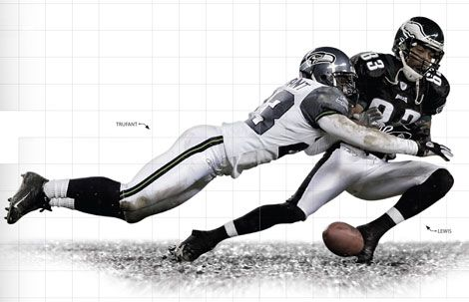
MEASURING FORCES
We will measure forces using newtons.
Notes:
Insert cover image and use transparency settings to fade image.

Slide 2
Do not delete this slide.
This slide is designed so that you can copy the prompt box you need and insert it into your slides.
This slide is hidden and will not be included when presenting your lesson.
TRACK WITH ME
VOCABULARY
1 -
HINT
Students, remember….
CHECK FOR UNDERSTANDING
READ WITH ME
TEACHER CUE
MAKE THE CONNECTION
Students, you already know….
EXTENSION
GESTURE WITH ME

Slide 3
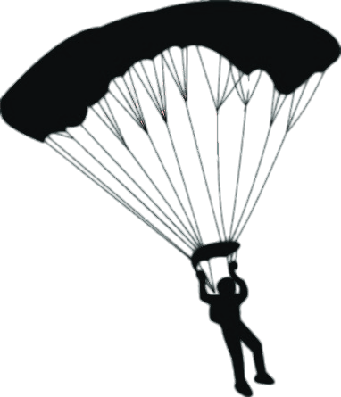
In this experiment, parachutes of different sizes were made.
The time that it took for the parachute to fall to the ground was measured with a stopwatch.
What is the independent variable?
What is the dependent variable?
List at least two controlled variables.

Slide 4
Repeat the opposite word/phrase.
INDEPENDENT VARIABLE
VARIABLE THAT IS CHANGED IN THE EXPERIMENT

Slide 5
Repeat the opposite word/phrase.
DEPENDENT VARIABLE
VARIABLE THAT IS MEASURED AND CHANGES

Slide 6
Repeat the opposite word/phrase.
CONTROLLED VARIABLE
VARIABLES THAT ARE KEPT THE SAME

Slide 7
Repeat the opposite word/phrase.
FORCE
A PUSH, PULL OR TWIST

Slide 8

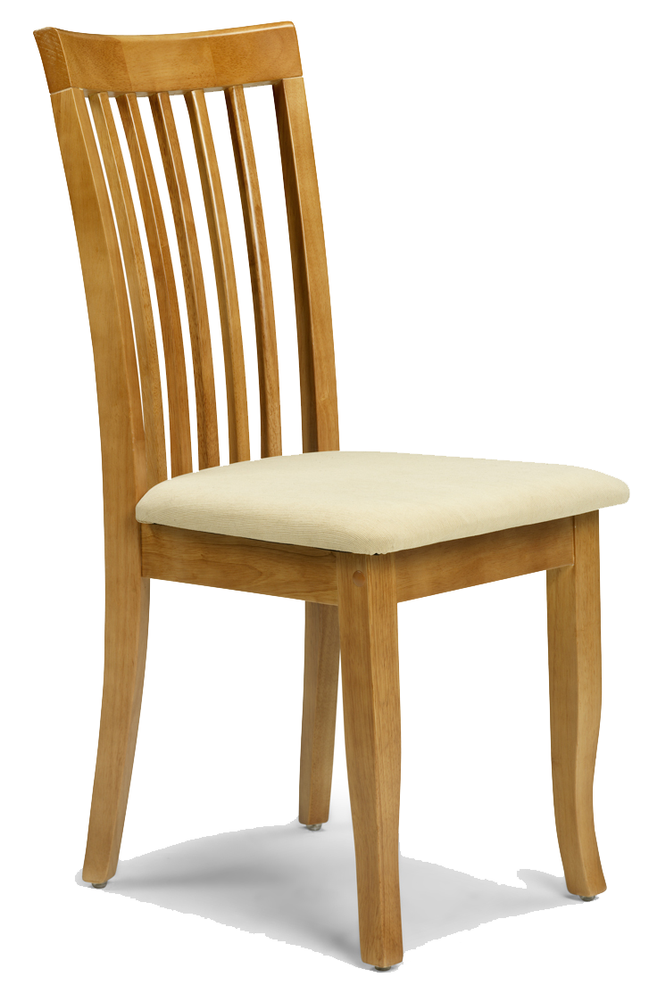
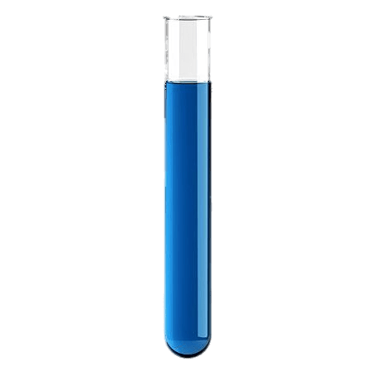
What are the three states of matter?
S _ _ _ _
L _ _ _ _ _
G _ _
What am I missing?

Slide 9
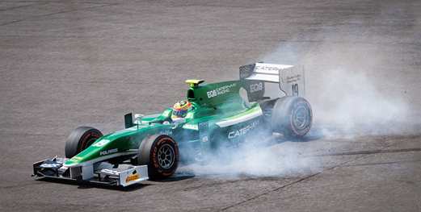
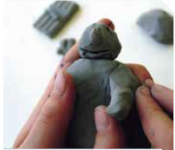
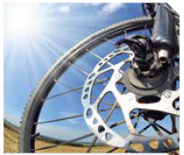

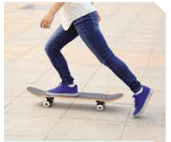
We will describe the effect of forces on familiar objects.
Match the image to one of the five things that forces can do.
Move something (acceleration)
Stop something moving (deceleration)
Change something’s direction
Turn something
Change something’s shape
E
A
B
C
D

Slide 10
We will investigate forces
TRACK WITH ME
READ WITH ME
We will define newton.
We will measure force using a newton meter.
DECLARE THE OBJECTIVE
Read the learning objective to your partner.
Notes:
Learning Objectives contain concepts (nouns, big ideas), skills (verbs, measurable behaviours) and sometimes context (restricting or targeting conditions).
●Example: Students will be able to describe the concept of density and apply it to floating and sinking.
●
Success criteria are specific measurable outcomes that if met mean that the student has met the learning objective.
Examples:
•Students will be able to compare densities of substances using mass and volume.
•Students will be able to identify whether a solid or liquid will float or sink in a liquid based on their densities.

Slide 11


We will measure forces using newtons.
MAKE THE CONNECTION
Think of some examples from primary school
In Science the word force means a push, pull or twist on an object.
Fill out this table with as many examples of these different forces.
2 minutes
Push | Pull | Twist

Slide 12
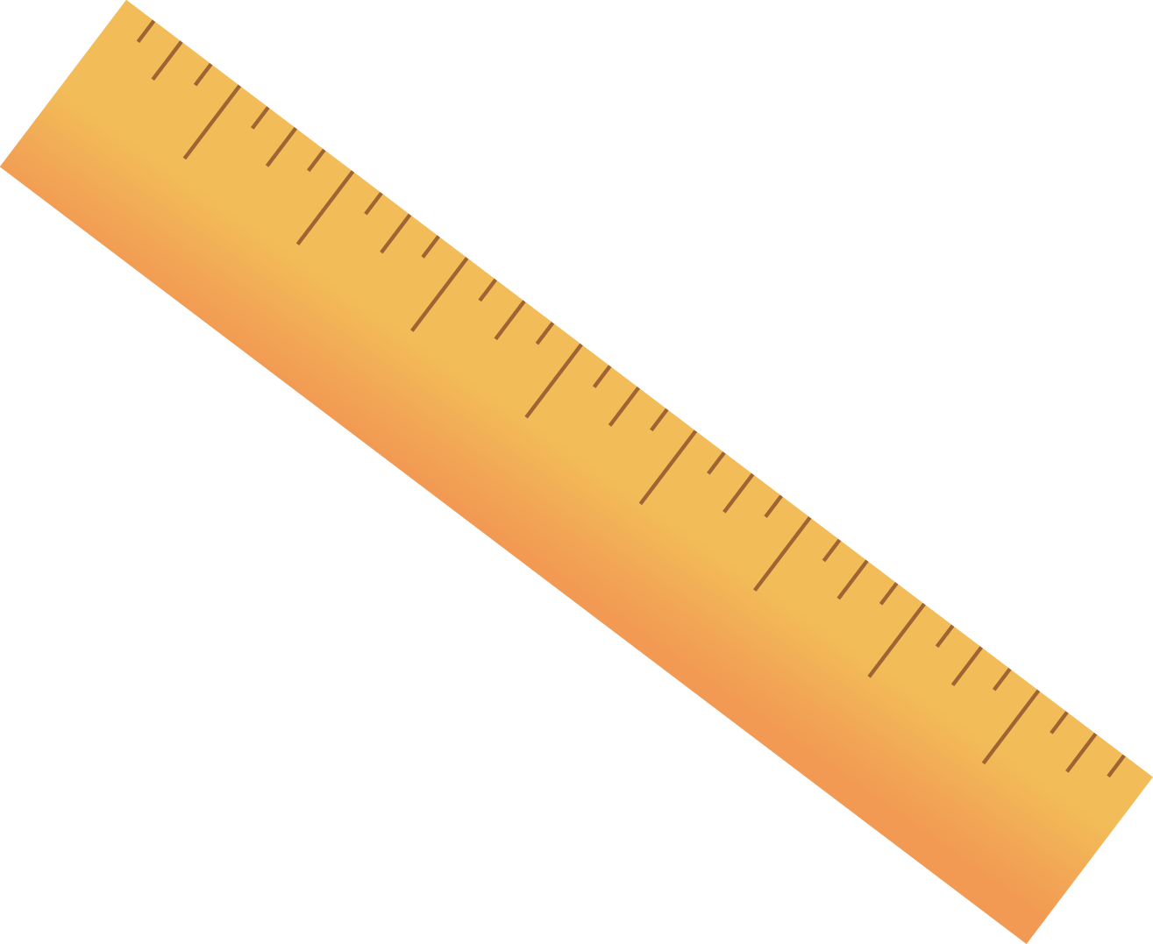
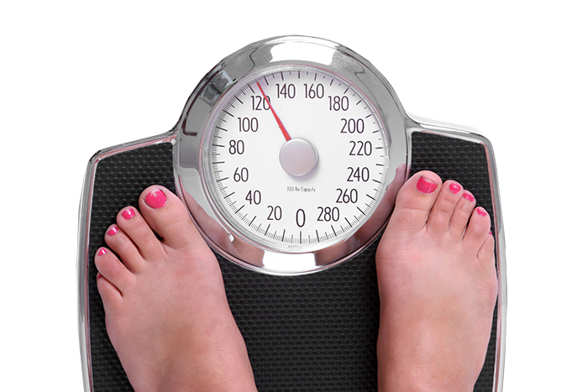
We will measure forces using newtons.
MAKE THE CONNECTION
Students, you already know that we measure our body weight using scales and we use a ruler to measure length
We know that we can’t see a force but we can see the effect of a force on an object.
One way to see the effect of a force is to measure it.
Can you think of what we use in our everyday lives to measure the effect of forces on objects?

Slide 13
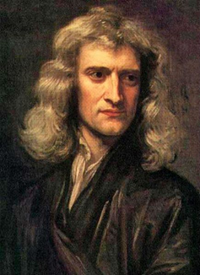
We will measure forces using newtons.
Units are measurements such as centimetres, minutes or kilograms.
In Science, forces₁ are measured using a unit called a newton₂.
The unit newton can be shortened to the letter N.
Newtons (N) is named after the English scientist Sir Isaac Newton.
CHECK FOR UNDERSTANDING
What unit is used to measure forces? What letter is used for the shorter unit of newton? Pair Share
VOCABULARY
1 - a push, pull or twist 2- unit used to measure force.

Slide 14
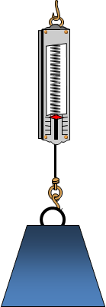
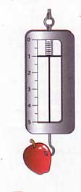
We will measure forces using newtons.
CHECK FOR UNDERSTANDING
What does a newton meter measure? What is the measurement of force? True or false: The larger an object the less newtons it has.
A newton meter (also called a spring balance) is a scientific tool used to measure force.
A spring in the balance stretches when an object pulls on it and this shows the force in newtons (N)
The larger an object, the larger the newtons.
The smaller an object the smaller the newtons.
1 newton is about the size of an apple = 100 grams.
10 newtons is about the size of a flour = 1 kg

Slide 15
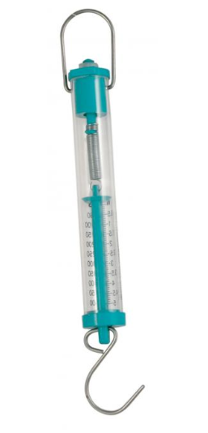
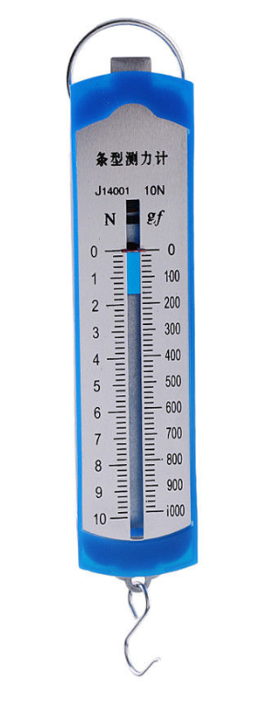
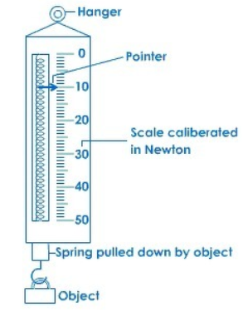
We will measure forces using newtons.
CHECK FOR UNDERSTANDING
What unit does a newton meter measure? What is the symbol for units? How do you read a Newton meter?
A newton meter (also called a spring balance) is a scientific tool used to measure forces.
Newton meters have different designs but they all measure newtons (N)
To read a Newton meter
Look at the side with the N symbol
Read the number next to the pointer.
This spring balance shows a force of 0N because there is no force acting on it.

Slide 16
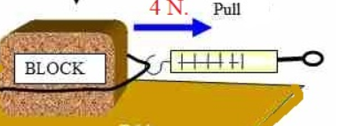
We will measure forces using newtons.
A Newton meter can also measure a force when an object is pulled on a surface. Newtons can be shown by a number followed by the letter N
This block is 4N of force to pull.
CHECK FOR UNDERSTANDING
How many newtons is the force of pulling this block? Is this force diagram showing a push, pull or twist?
Newton meter reads 4N

Slide 17
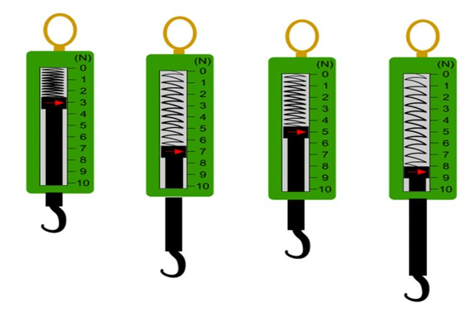
1 minute
We will measure forces using newtons.
Read the pointer in the newton meters below and calculate the newtons (N) for A-D
A B C D
Spring Balance | Force (N)
A
B
C
D
Teacher Cue
Complete A together

Slide 18
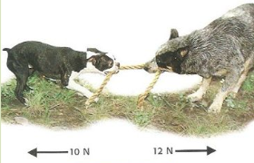
We will measure forces using newtons.
Forces₁ act on everything around us all the time.
Every force can be measured in newtons.
It is important to know how forces affect objects so you can explain everyday tasks using physics.
CHECK FOR UNDERSTANDING
What dog is pulling with a force of 10N? Predict what is going to happen in this picture.
Dog 1
Dog 2
VOCABULARY
1 - a push, pull or twist

Slide 19
We will describe the effect of forces on familiar objects.
Forces₁ are measured using a unit called the newton.
Newton meters (or spring balances) measure forces₁.
CHECK FOR UNDERSTANDING
How is a force measured in a science laboratory?
VOCABULARY
1 - a push, pull or twist

Slide 20
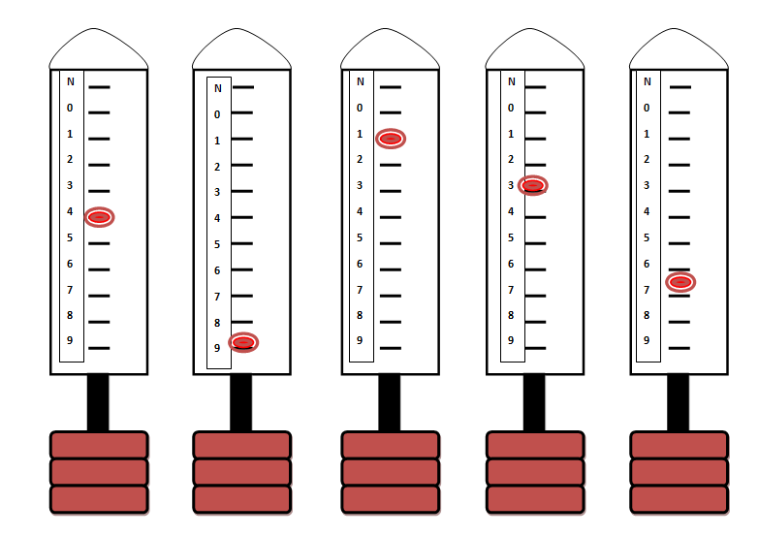
HINT
In Science, forces₁ are measured using a unit called a newton₂. Newtons are a measure of force. The unit newton can be shortened to the letter N.
We will measure forces using newtons.
Answer the questions below in your book (full sentences)
Find the newtons (N) of newton meters 1-5.
What is a force?
What is a newton?
What is the symbol for a newton?
True or false: Pulling an object can be measured in newtons?
What would have more newtons in the following: An apple (100g) or a bag of flour (1kg)
1 2 3 4 5
Notes:
Please include tasks/questions here rather than just referring to a worksheet. This will save on photocopying and facilitate sharing with other schools.
Try and build tasks/questions which escalate through Bloom’s Taxonomy. This will help with differentiation.

Slide 21
We will measure forces using newtons.
TRACK WITH ME
READ WITH ME
We will define newton.
We will measure force using a newton meter.
DECLARE THE OBJECTIVE
Read the learning objective to your partner.
Notes:
Learning Objectives contain concepts (nouns, big ideas), skills (verbs, measurable behaviours) and sometimes context (restricting or targeting conditions).
●Example: Students will be able to describe the concept of density and apply it to floating and sinking.
●
Success criteria are specific measurable outcomes that if met mean that the student has met the learning objective.
Examples:
•Students will be able to compare densities of substances using mass and volume.
•Students will be able to identify whether a solid or liquid will float or sink in a liquid based on their densities.

Slide 22

We measure force in newtons (symbol: N), which is named after the 17th century English scientist, Sir Isaac Newton.
It takes approximately 1N of force to lift an apple.

Slide 23
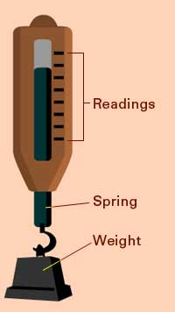
We will measure forces using newtons.
CHECK FOR UNDERSTANDING
•How much will 4kg be in newtons ______ •How much will 100 newtons be _____ kg
1 kg = 10 Newtons
•70 kg = 700N
•20 kg = 200N

Slide 24
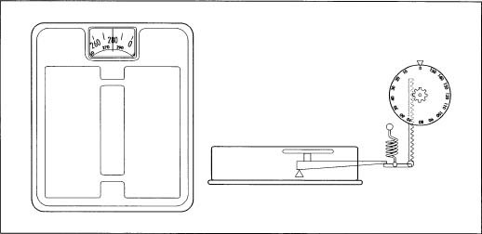
We will measure forces using newtons.
CHECK FOR UNDERSTANDING
What are kitchen/bathroom scales measuring? What do scales use to measure a force? Pair Share
In the kitchen, cooks use scales to measure how much the Earth’s gravity pulls on the ingredients.
For example twenty grams of flour is pulled to the centre of the Earth, causing the flour to push down on the scales.
Scales use a spring that is squashed or compressed to measure force.

Slide 25
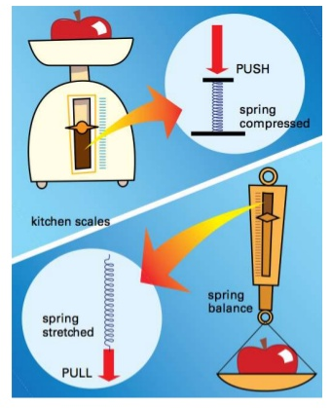
We will measure forces using newtons.
CHECK FOR UNDERSTANDING
What can we use to measure force?
A spring balance, bathroom scale, and kitchen scale all measure force.
They are measuring what is pressing down (pushing) on them (kitchen/bathroom scales) or what is pulling on them (spring balance).

